Slide 1
Photo Editor

Slide 2
2
Software Project Lab 1
CSE 305
Project Name: Image processor
Name: MD Ahasanul Islam Talukder
Roll: BSSE 1024
Supervised By: Mohd. Zulfiquar Hafiz
Github Link:
https://github.com/AhasanulIslam/Photo_Editor

Slide 3
Project Description:
3
My project is about photo editing tools. Where user can apply several effects.
Gray Scale.
Negative.
Black and White.
Solaris.
Mirror.
Sepia.
Also can red, blue, green and yellow.
User can crop his image.
An image can be more brighter or more darker by this.

Slide 4
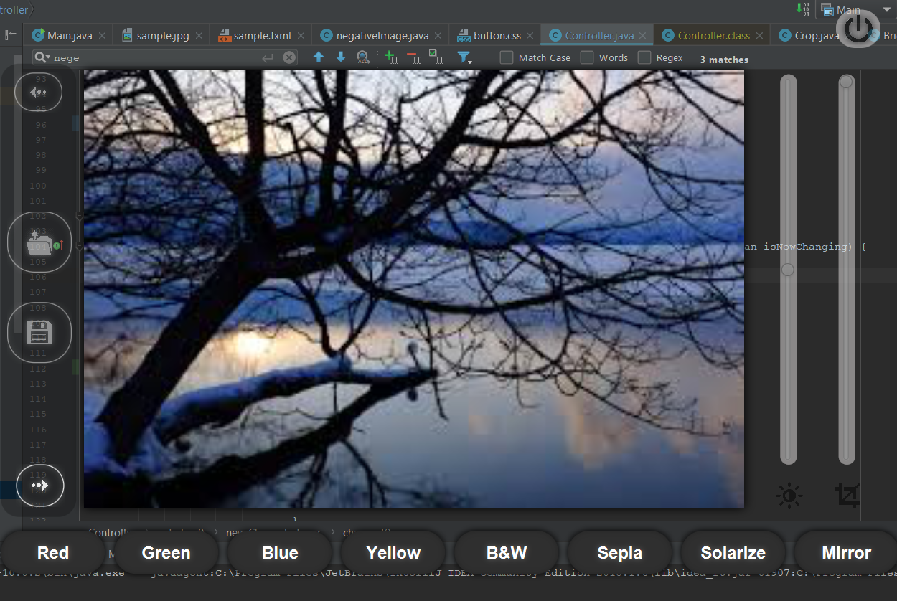
Key Features:
1
Add effect
2
Crop image
3
Increase or decrease Brightness
4
Rotate an Image
5
Notes:
Image source:-
https://pixabay.com/en/technology-industry-big-data-cpu-3092486/

Slide 5
Add Effect:
5
User can add different effects by using this tool. The effect are:
Red.
Blue.
Green.
Yellow.
Sepia.
Solarize.
Black and White.
Negative.

Slide 6
Add Effect:
5
Firstly I input an image from file by using ImageIO.read()
Then I read the orginal value of image.
Finally I change the RGB value for several effects. Some effects are given below

Slide 7
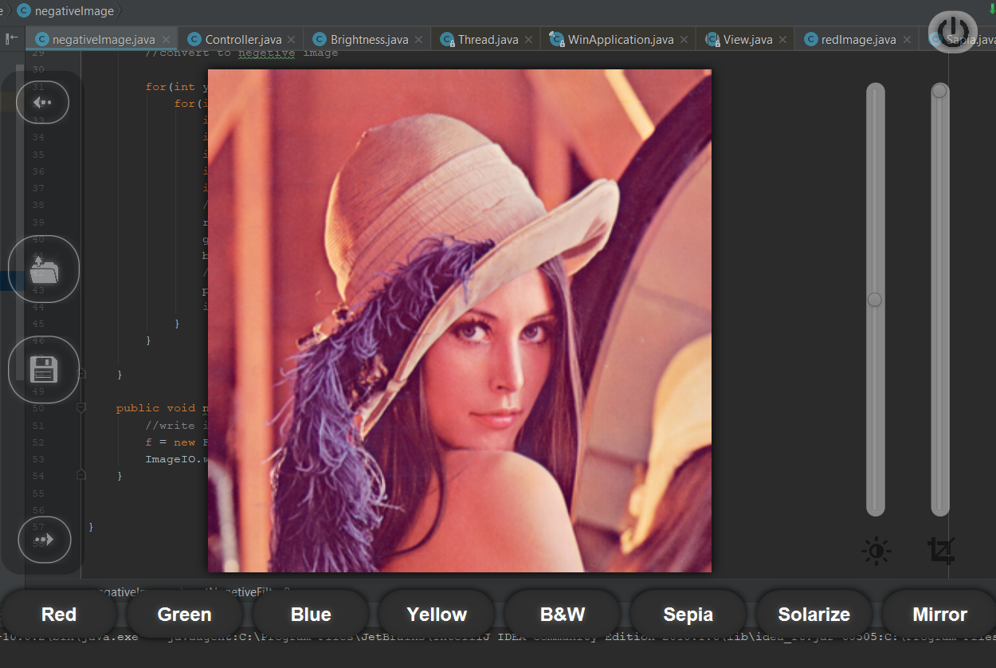
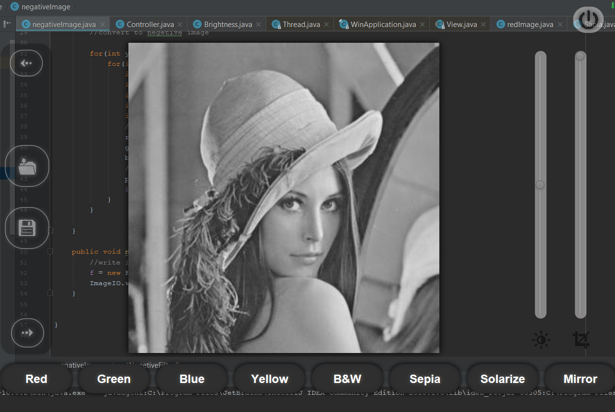
Add Effect:
5
.For Gray Scale
Average = (red + green + blue)/3
red = average
green= average
blue= average

Slide 8
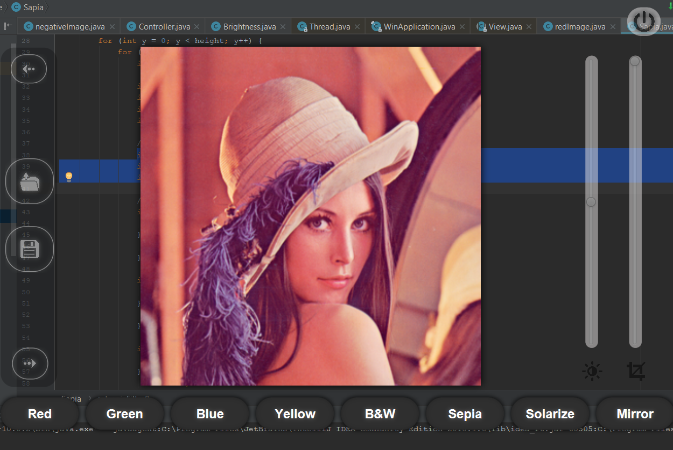
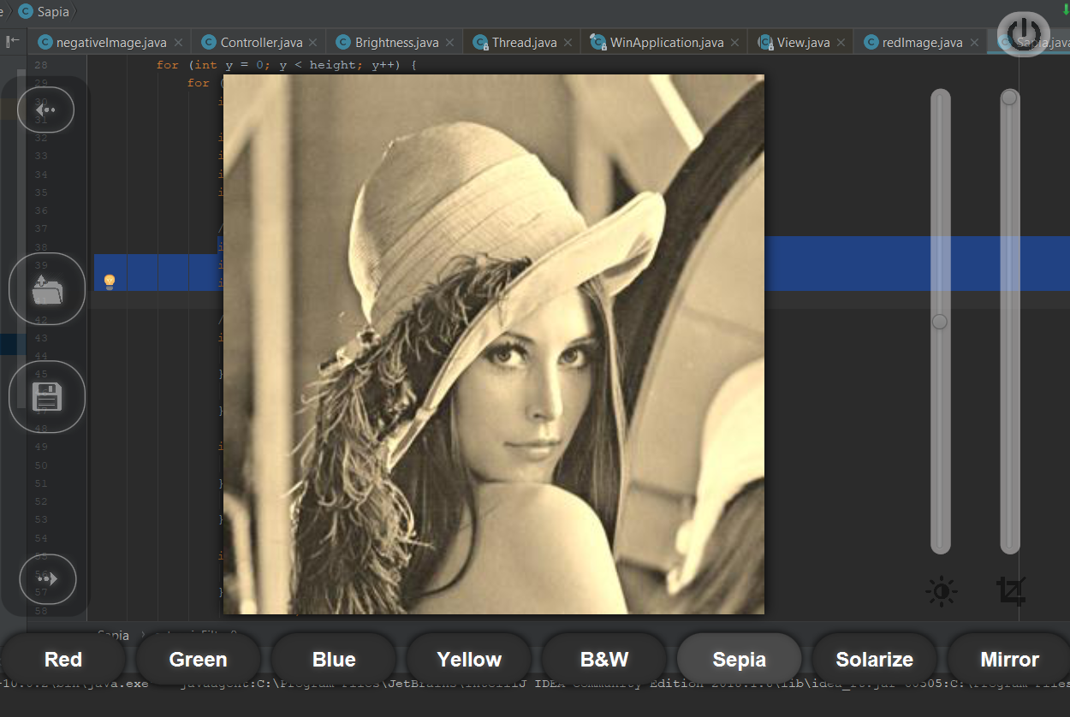
Add Effect:
5
Sepia Effects
int tr = (int) (0.393*r + 0.769*g + 0.189*b)
int tg = (int) (0.349*r + 0.686*g + 0.168*b)
int tb = (int) (0.272*r + 0.534*g + 0.131*b)

Slide 9
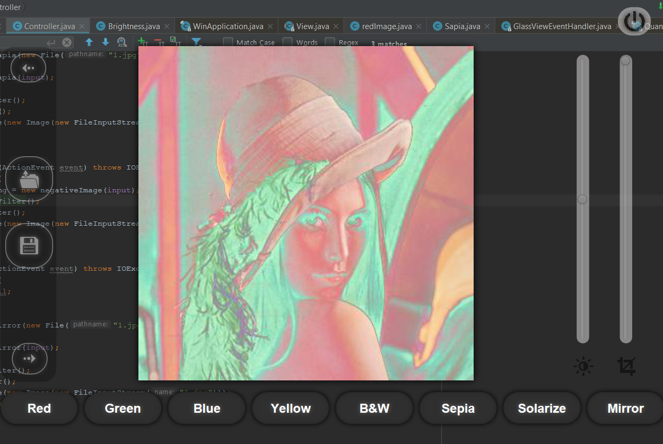
Add Effect:
5
Solarize Effect
I make this solarize effect by using this calculation..
if(r <= 127) r = 255-r;
if(g <= 127) g = 255-g;
if(b <= 127) b = 255-b;

Slide 10
Add Effect:
5
By changing RGB value we can create some effect like red, blue, green and yellow.
Red
The green and blue color value of each pixel is set to 0.
Blue
The red and green color value of each pixel is set to 0.
Green
The red and blue color value of each pixel is set to 0.
Yellow
The blue color value of each pixel is set to 0.

Slide 11
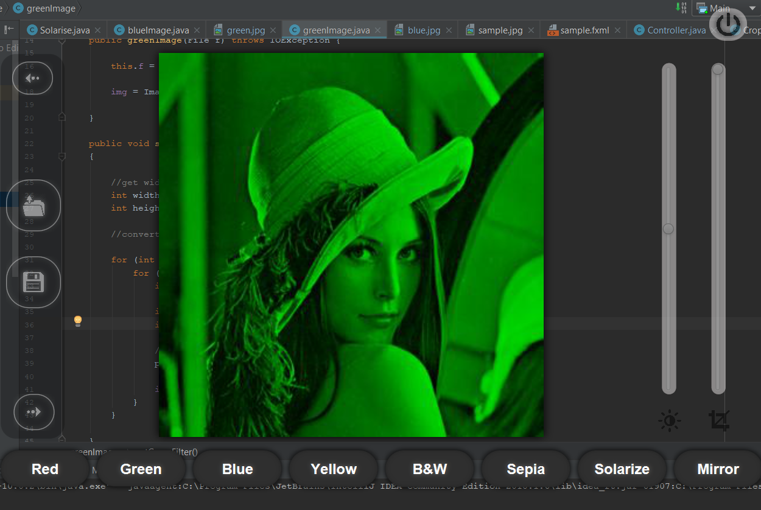
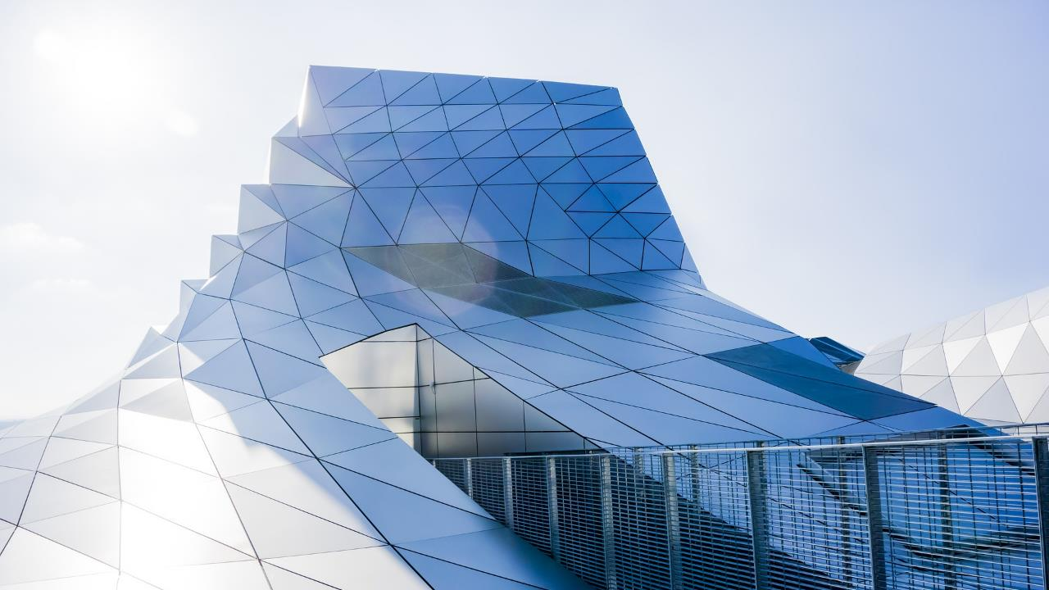
Add Effects
Here I give a example of Green.
For green red and blue color value of each pixel is set to 0.
6
Notes:
Image source:-
https://pixabay.com/en/architecture-building-business-2179108/

Slide 12
Crop Image
For crop an Image I use amount. Which is multiple with height and weight. Then get a tergetheight and tergetweight. This is use for crop image.
This is a square crop so it crop from center.
int targetWidth = (int)(width * ammount); int targetHeight = (int)(height * ammount); // Coordinates of the image's middle int xc = (width - targetWidth) / 2; int yc = (height - targetHeight) / 2;
Notes:
You can safely remove this slide. This slide design was provided by SlideModel.com – You can download more templates, shapes and elements for PowerPoint from http://slidemodel.com

Slide 13
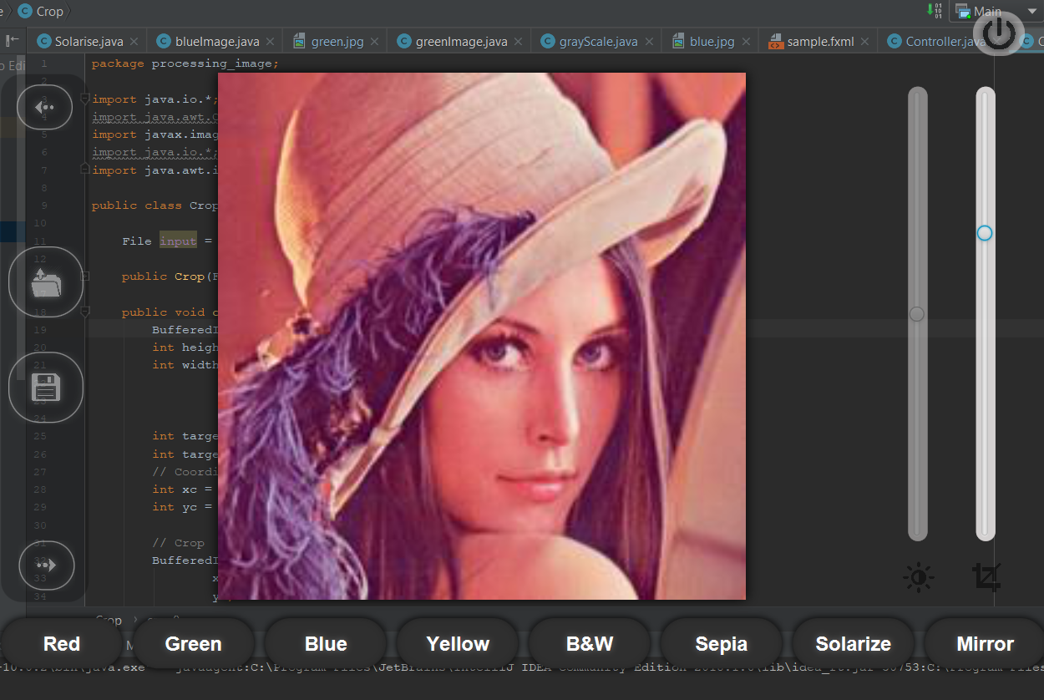
Thank You
Notes:
You can safely remove this slide. This slide design was provided by SlideModel.com – You can download more templates, shapes and elements for PowerPoint from http://slidemodel.com

Slide 14
Brightness
In brightness use factor with is add with red, blue and green.
Then it will increase or decrease the pixel color.
int r = (int) (c.getRed() + factor); int b = (int) (c.getBlue() + factor); int g = (int) (c.getGreen() + factor);
If the factor value is getter then 0 then it will be brighter
Notes:
You can safely remove this slide. This slide design was provided by SlideModel.com – You can download more templates, shapes and elements for PowerPoint from http://slidemodel.com

Slide 15
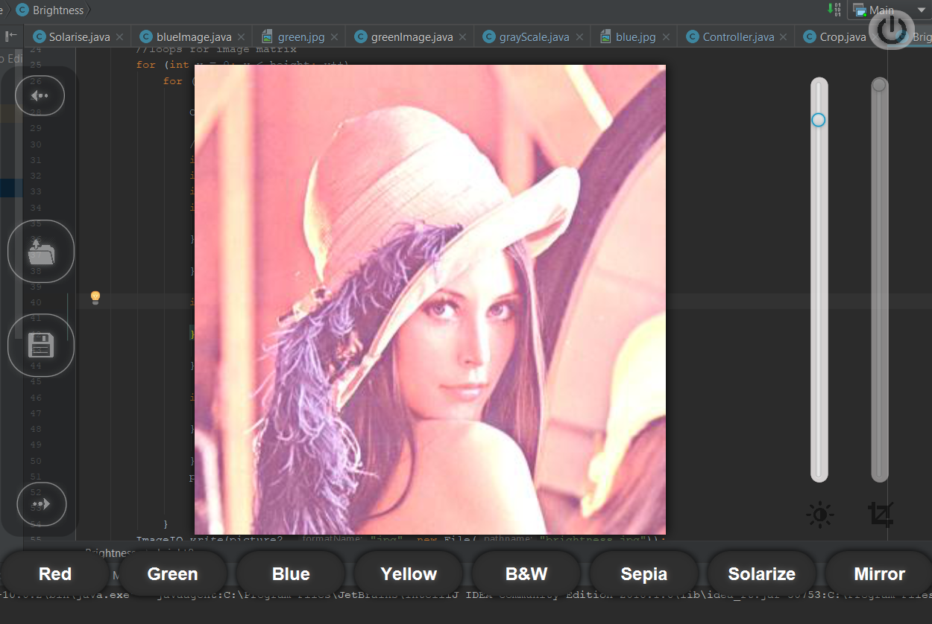
Notes:
You can safely remove this slide. This slide design was provided by SlideModel.com – You can download more templates, shapes and elements for PowerPoint from http://slidemodel.com

Slide 16
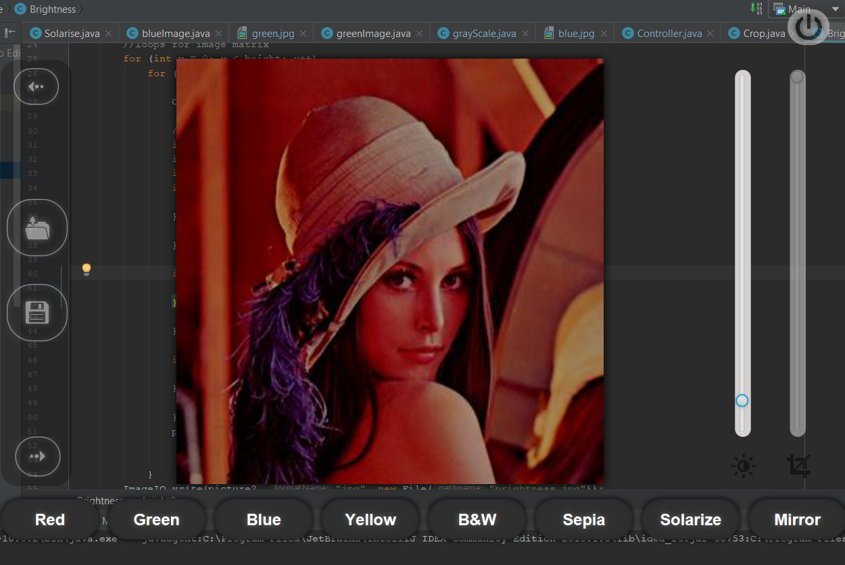
If the factor value is negative then it became darker.
Notes:
You can safely remove this slide. This slide design was provided by SlideModel.com – You can download more templates, shapes and elements for PowerPoint from http://slidemodel.com

Slide 17
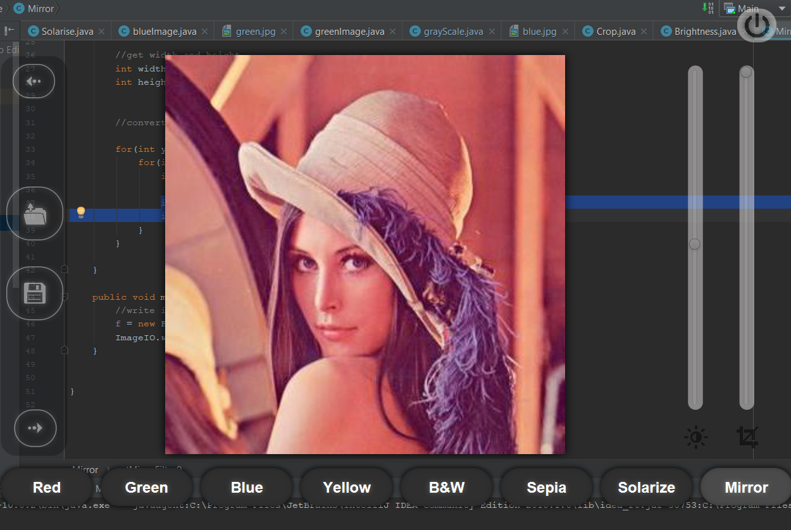
Rotate an Image
Using mirror effect for rotating an image.
img.setRGB(x, y, img.getRGB(width - 1 - x, y)); img.setRGB(width - 1 - x, y, p);
Notes:
You can safely remove this slide. This slide design was provided by SlideModel.com – You can download more templates, shapes and elements for PowerPoint from http://slidemodel.com

Slide 18
Thank You
Notes:
You can safely remove this slide. This slide design was provided by SlideModel.com – You can download more templates, shapes and elements for PowerPoint from http://slidemodel.com

